Slide 2
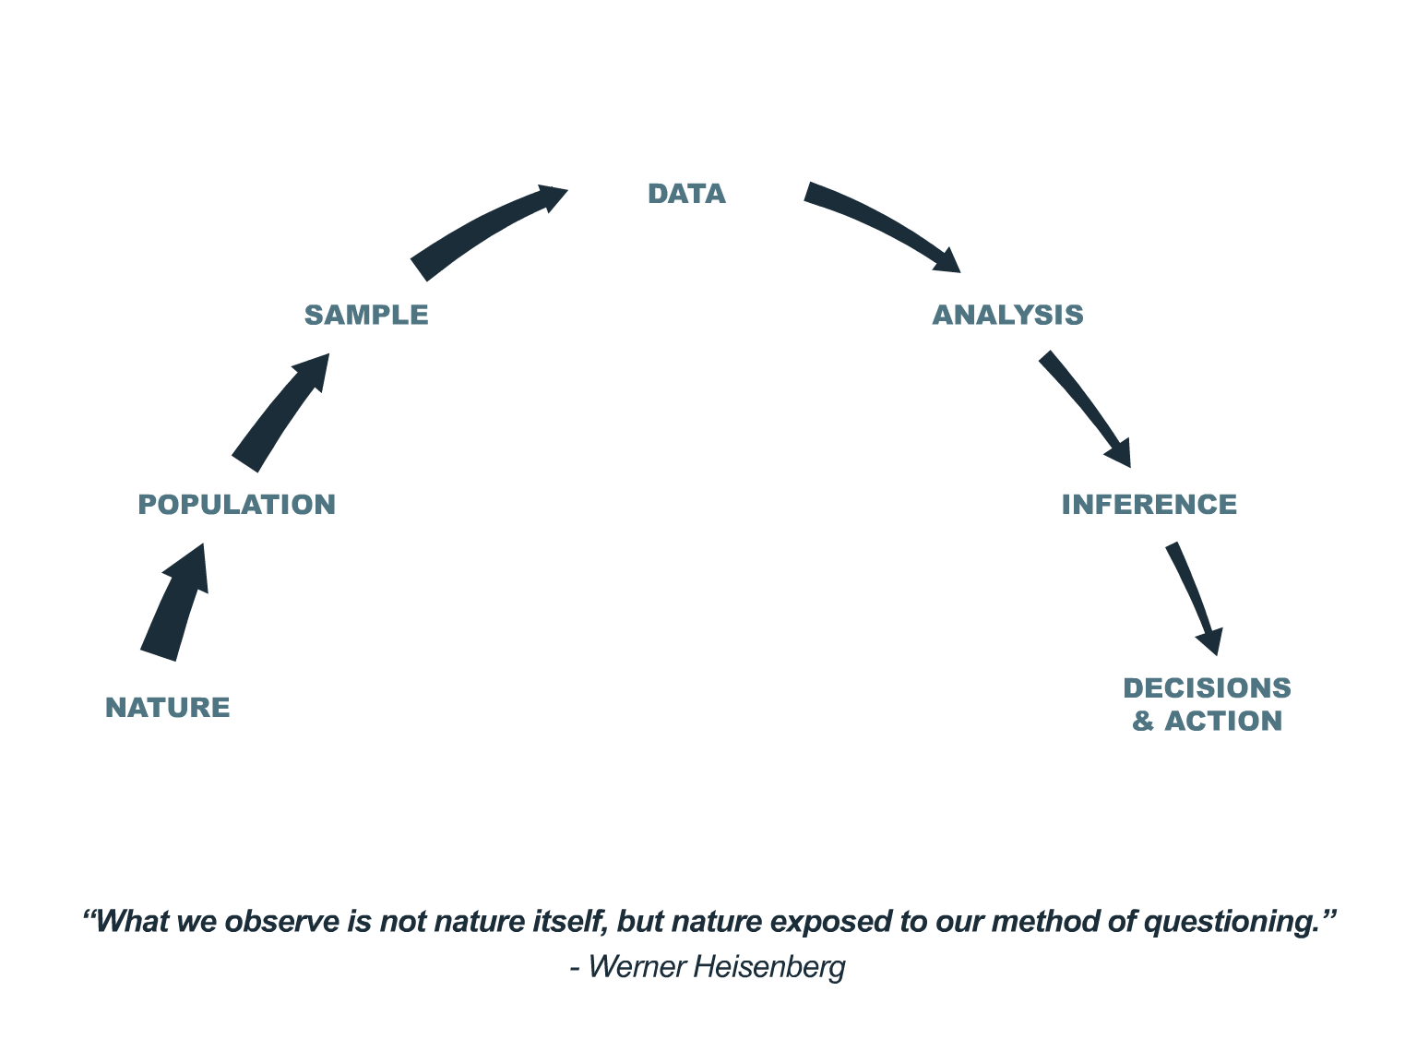
Epistemology; “meta-research”
Integrity of evidence, inference, decisions and outcomes
Patient-oriented evidence
Notes:
I am interested in ‘how we know what we think we know’ (epistemology); and especially interested in our blind spots.
This leads to research about how we do research: ‘meta-research’
Comprehensive/circumspect perspective: valuable because:
(1) we tend to focus on only parts of the process, and there is value in seeing it as a set of inter-dependencies; (2) and because it is at the boundaries and hand-offs that things tend to break down; such as when an analyst munges whatever data is provided or convenient, tortures the available data with a regression model, and is well satisfied to supply a p-value to clinical investigator and move on to the next deliverable.
Ultimately this is about the coherence and Integrity of our evidence, inference, decisions and outcomes.
The talk is not especially technical, it is more philosophic. There is nothing really novel – but I believe considering, focusing on, and representing evidence generation on a continuum, as network—a cascade-–of dependencies has advantages and benefits.
The motivation and concerns of this perspective may represent more about my experience of working in observational data analysis mostly in Pharma, and my read of the health care field than anything else.
This perspective is oriented toward providing the best outcomes for patients as an organizing and motivating ethical principle: not about

Slide 3



Perspective: the “Big” picture
Notes:
Fire Lookout on Mt. Tam: 360-degree views 50+ mile vistas
An opportunity to reflect:
on what is important in life
on epistemology and decision-making
on scientific reasoning
on prediction modeling
on the current juggernaut machine learning and when and how it useful and not useful
on the direction of health science research…

Slide 4

Notes:
Statistical sciences and health research has a sort of 'approach avoidance' to an acknowledged crisis in research reproducibility with implications for scientific credibility.

Slide 5
Notes:
We know there is a serious problem, but we sort of dither about what to do about it.
This interests me.

Slide 6
Numerous threats militate against validity, reproducibility, integrity of inference, and the self-correcting mechanism of the scientific method.
“Sampling error is only one component in a long sequence of distortive forces in the scientific process informing the clinical knowledge base, and often not the most important.” ---Sander Greenland
Notes:
Numerous threats militate against validity, reproducibility, integrity of inference, and the self-correcting mechanism of the scientific method.
"Sampling error is only one component in a long sequence of distortive forces in the scientific process informing the clinical knowledge base, and often not the most important".
This arc is a conceptual idealization of the scientific process informing the clinical knowledge base focusing on Observational Data Analysis (ODA). We can deconstruct the process of generating scientific evidence via ODA and identify prevalent sources of potential distortion of information and inference.
Between each node in the process cascade is a connection

Slide 7
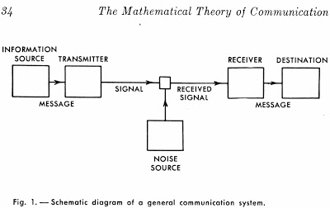
Notes:
Many methodological and systematic pitfalls introduce loss and distortion of the “signal” representing causal relationships in nature, much as noise compromises transmission in a communication channel.
In this analogy, nature is the source, the message is a causal phenomenon to be modeled, transmission is the research process, noise comprises the sources of uncertainty described above, and the destination is the scientist’s or decision-maker’s mind.

Slide 8
Numerous methodological and systematic pitfalls introduce loss and distortion of the “signal” representing causal relationships in nature, much as noise compromises transmission in a communication channel.
Notes:
Numerous methodological and systematic pitfalls introduce loss and distortion of the “signal” representing causal relationships in nature, much as noise compromises transmission in a communication channel.
The attenuation in the size of the arrows representing the transmissions of information between nodes represents the degradation of information through the continuum of the scientific process informing the clinical knowledge base.
Our information uncertainty tends to increase in the process. This is information entropy.

Slide 9
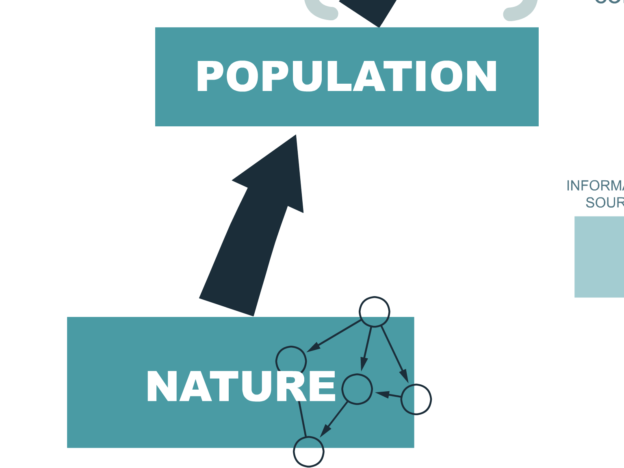
Nature is the nexus of causes that produce all phenomena actually or potentially available for empirical study.
Notes:
Nature is the nexus of causes that produce all phenomena actually or potentially available for empirical study. The underlying causal structure of nature is often abstruse or inscrutable.

Slide 10
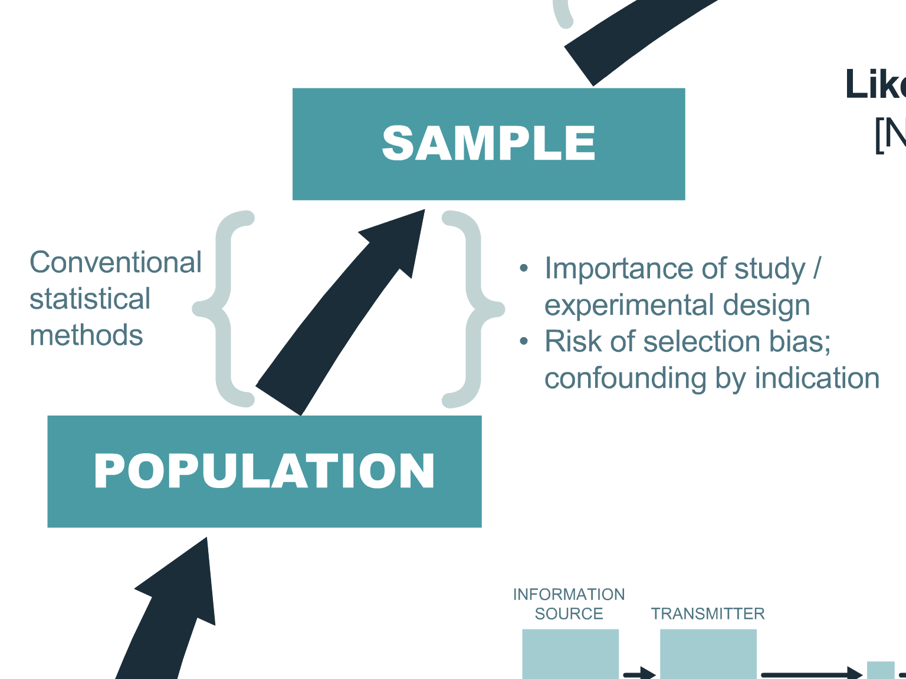
A population is a set of phenomena (existing, nonextant, and/or possible) in some category of interest for study. A population is the realization of a causal process in nature and is the primary object of study and inference.
Notes:
A population is a set of phenomena (existing, nonextant, and/or possible) in some category of interest for study. A population is the realization of a causal process in nature and is the primary object of study and inference.

Slide 11
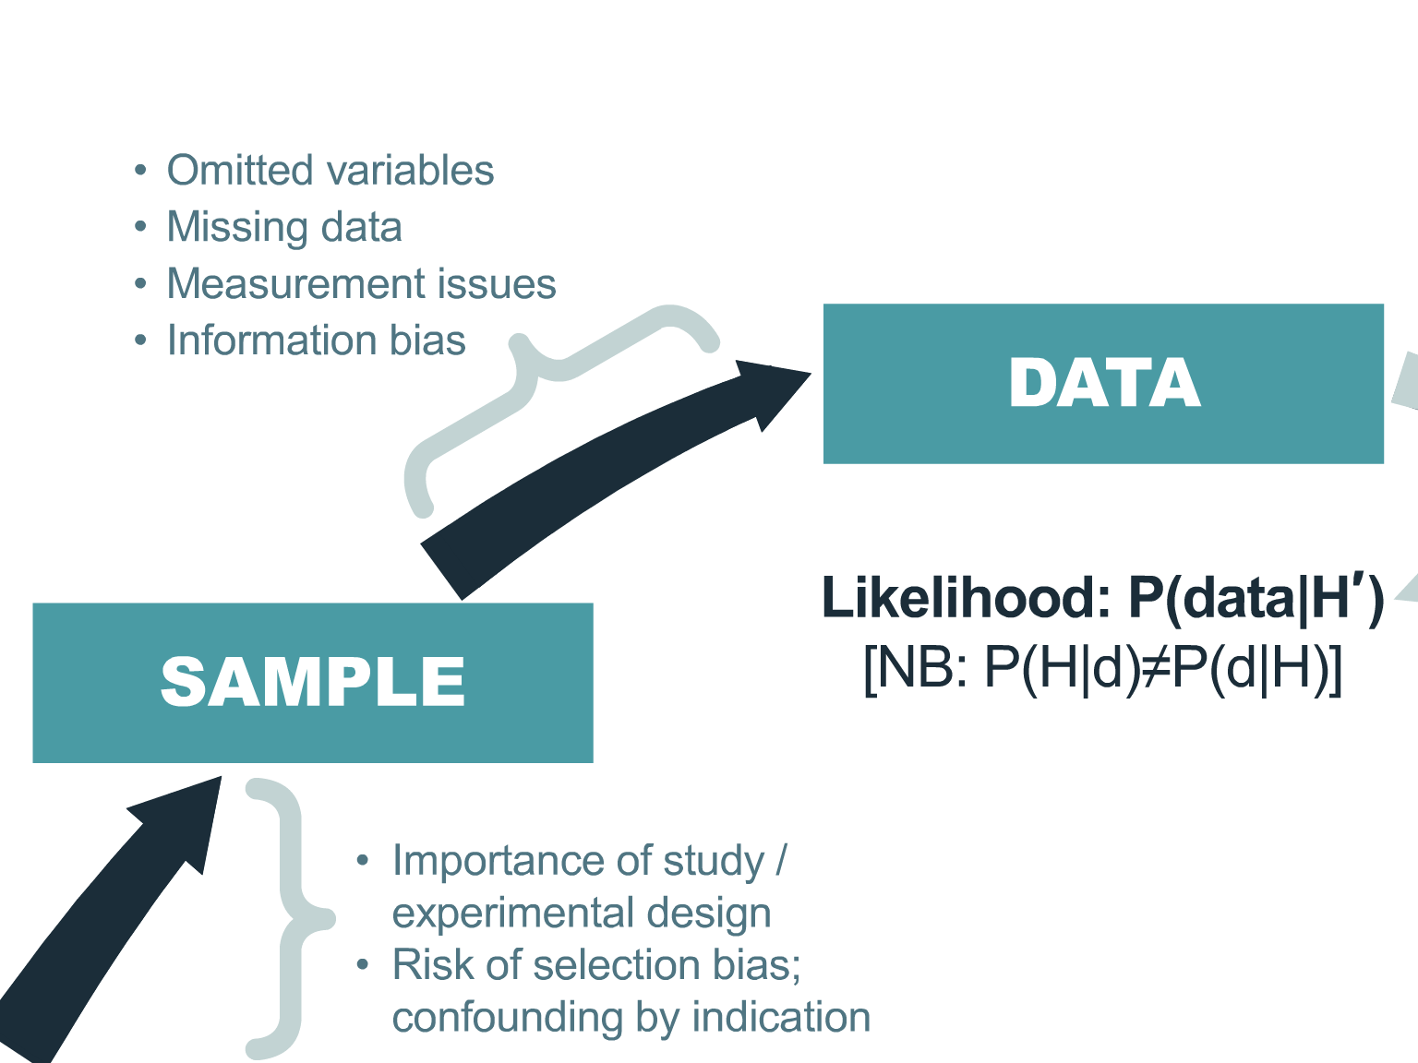
The particular data set gathered, out of many possible instances, and including all sources of noise, informs the likelihood on which the analysis is predicated.
Records of observations made of the sample constitute the data. Of all possible observations on the sample only some are made, and all observations are made and recorded with some probability of error at each step.
Notes:
Records of observations made of the sample constitute the data. Of all possible observations on the sample only some are made, and all observations are made and recorded with some probability of error at each step.
The particular data set gathered, out of many possible instances, and including all sources of noise, informs the likelihood on which the analysis is predicated.
This is the data generating process for primary and secondary data…

Slide 12
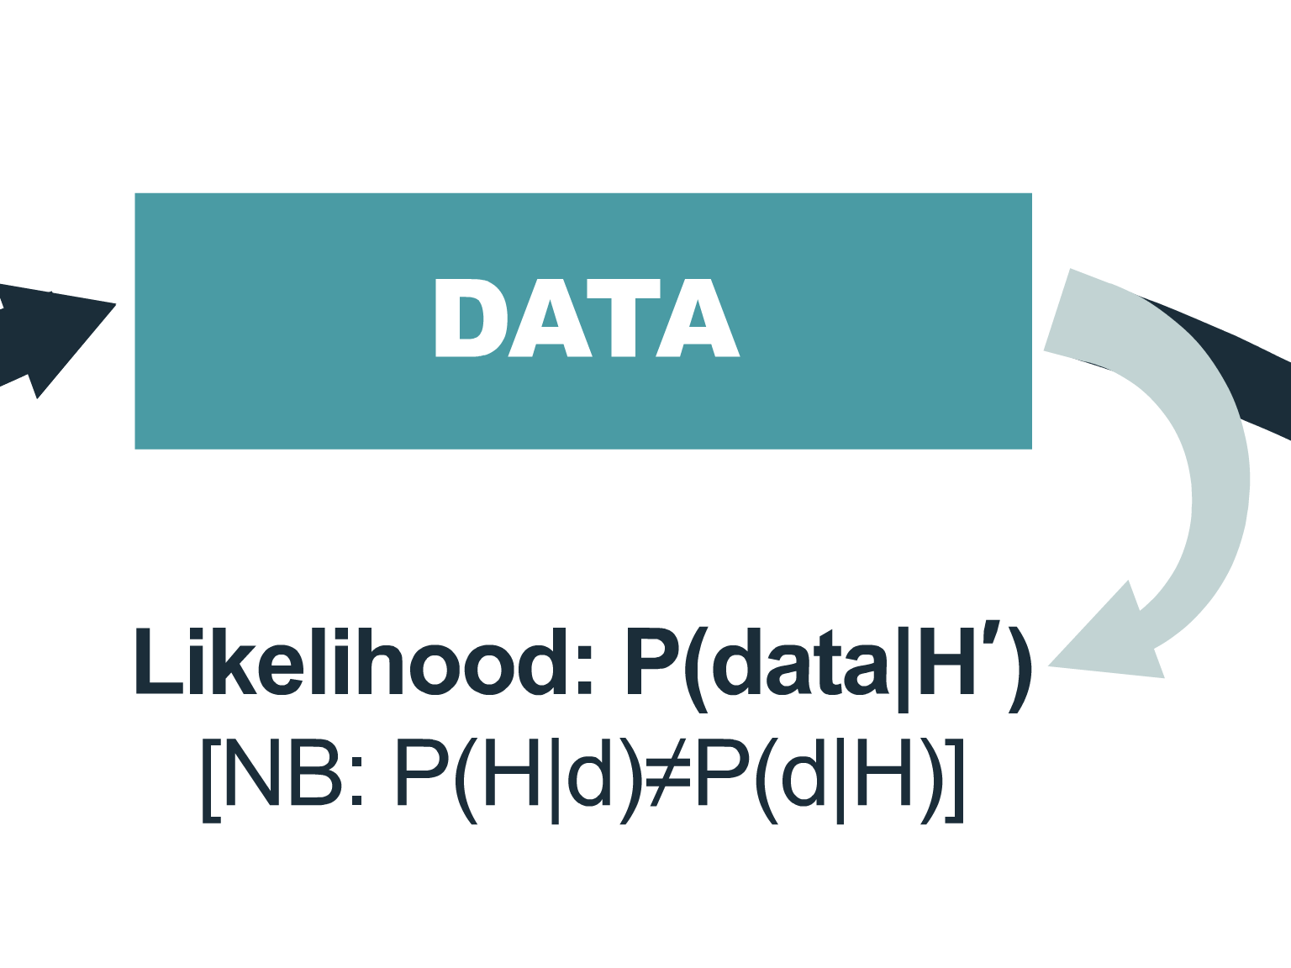
It is easy to be fooled by data!
Notes:
This is where most ODA projects actually start; especially secondary data analyses and “Data Science” efforts: with received data created elsewhere.
It is easy to be fooled by data!
NB: What we want as evidence is P(proposition | data and other information) ; but, what we get from data is a likelihood, the probability of the data conditional on a number of assumptions that are often obscure.
The distinctions between these two conditional probabilities is often confused by the consumers of our research.
A p-value is “jumping to a conclusion”, and reflects the stubborn preference for cognitive ease in decision making. The p-value is not simply facile reasoning—it is a logical fallacy based on a false dichotomy and on ‘satisficing' with an answer to a different (a wrong) question: the P(data | an obliquely relevant proposition {"the null hypothesis”}) in lieu of the correct question, the P(hypothesis | evidence). NHST is masquerading as a definitive causal syllogism, and more often than not leads to reflexive, un-deliberate behavior (decision making) which have untoward impacts (e.g., for individual patient interests and outcomes). The NHST impersonates, but is not, formal deductive falsification (Popper), or strong inference (Platt). It is a “tool" that serves as a misguided expedient. But more importantly, it diverts attention from the real issue: P(pt benefit | Tx) which can be explicitly and directly estimated as a posterior probability.

Slide 13
“If you’ve got decent data and more importantly a likelihood that actually makes fairly specific scientifically based predictions, then you typically find out a lot and the prior matters less. If you’ve got a poorly specified model and badly thought out experiment, or haphazardly collected observational data, there’s not much you can do to make your likelihood inform your posterior.
The part that people tend to get wrong, in my opinion, isn’t the prior, it’s the model of the world that informs their likelihood, and/or the design of the data collection.”
--Daniel Lakeland
Notes:
I think there is so much wisdom in this quote by Daniel Lakland.
It reflects the importance of positing and articulating a model of how the world works and how the data were generated; and suggests the problem underlying a lot of machine learning and data mining.

Slide 14
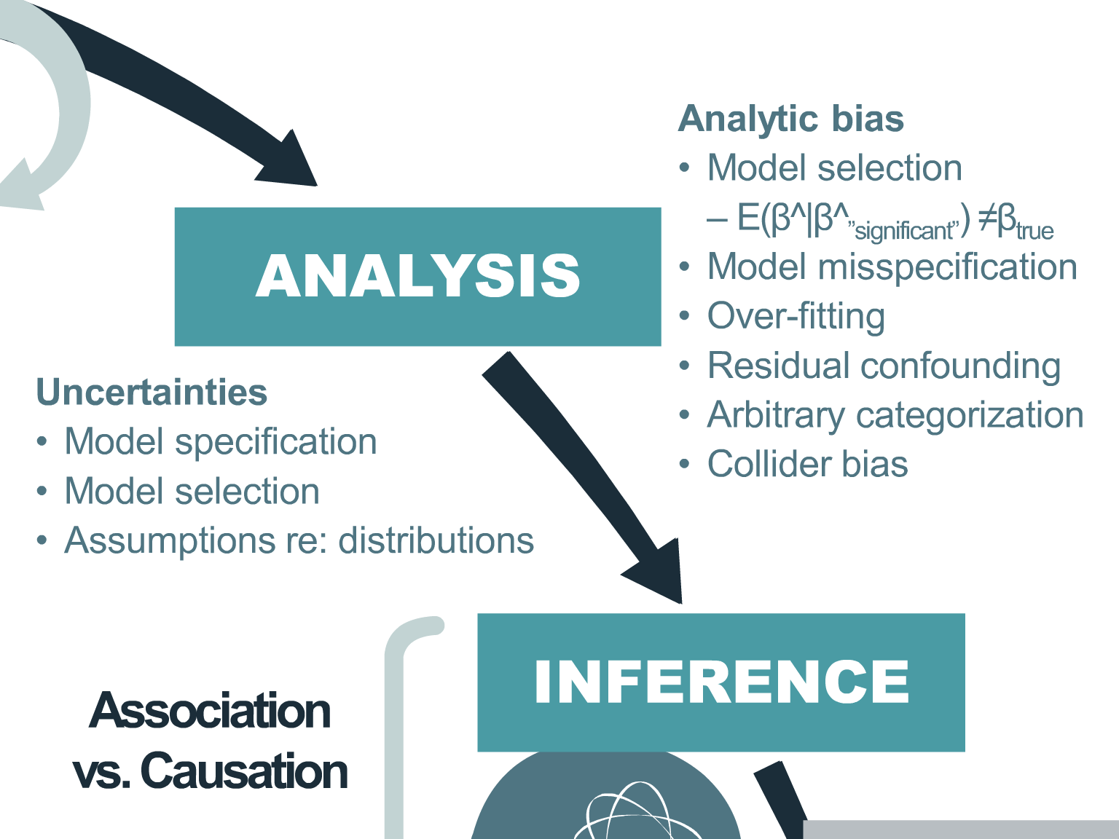
Notes:
Analysis comprises mathematical procedures that seek to account for both the structure and randomness of the data.
Frank Harrell’s RMS, and E. Steyerberg’s Clinical Prediction Modeling provide the best intelligence on navigating these issues.
The distorted equation is an admonition about automated variable selection methods. It is a “noise” machine.
I suspect that collider bias – bias induced by inappropriate adjustment --- is more prevalent than appreciate: no one is checking this or evaluating how common it is.

Slide 15
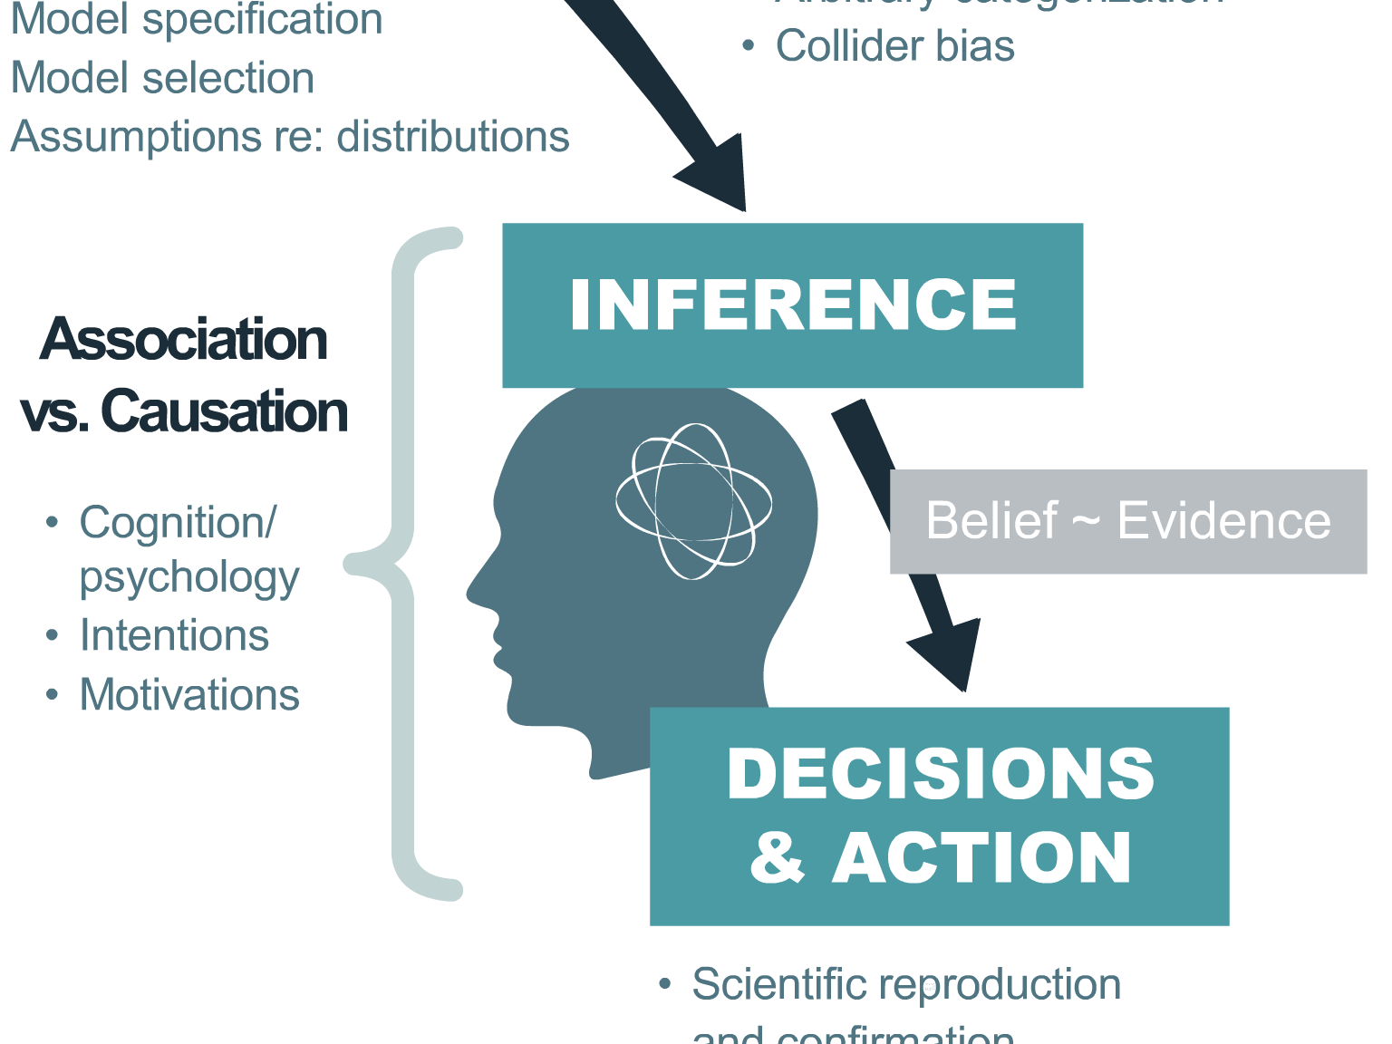
The myth of rational objectivity:
‘our thinking suffers from overconfidence, bias, and various distortions of reasoning…’
-Daniel Kahneman (“Thinking Fast and Slow”)
Notes:
The myth of objectivity.: humans are not rational beings that process information with consistency and logic.
According to Daniel Kahneman (“Thinking Fast and Slow”) and others, how we make judgements and take actions is colored by innate biases, flawed assumptions and prejudices. And we are clueless about how these influence our judgements.
We need to have the humility to recognize the various and numerous ways our thinking suffers from overconfidence, bias, and various distortions of reason; and as a first impulse consider whether and how we are stepping into numerous psychological traps and conceits in the way we address the issues here. We ought to be vigilant for the profound effect of cognitive biases that shape our judgments and decisions. If you have any doubts or questions about the importance and prevalence of this, please read Kahneman. Let's admit the necessity for metacognition: we should think more carefully about how we think, and bear this in mind as we navigate toward a resolution concerning inference, evidence, and knowledge.
The specific mechanics of reasoning with/from data, making judgements about evidence vs. clinical decision making are critical. Judgement about evidence (probably should be further differentiated into credibility for causal inference vs. relevance of evidence for the problem it is being applied to) precedes and should remain unconditioned by clinical decision making.

Slide 16

Judgement and decision making activity is always situated in richly textured social relationships, emotional states, limited cognitive capacity, numerous biases, and complex practicalities; and cannot be fully separated from them.
Notes:
Judgement and decision making activity is always situated in richly textured social relationships, emotional states, limited cognitive capacity, numerous biases, and complex practicalities; and cannot be fully separated from them.

Slide 17
Deconstructed the process of generating scientific evidence via ODA and identified prevalent sources of potential distortion of information and inference.
What recourse do we have?
Notes:
Deconstructed the process of generating scientific evidence via ODA and identified prevalent sources of potential distortion of information and inference.
This is likely incomplete and superficial and there is surely more.

Slide 18
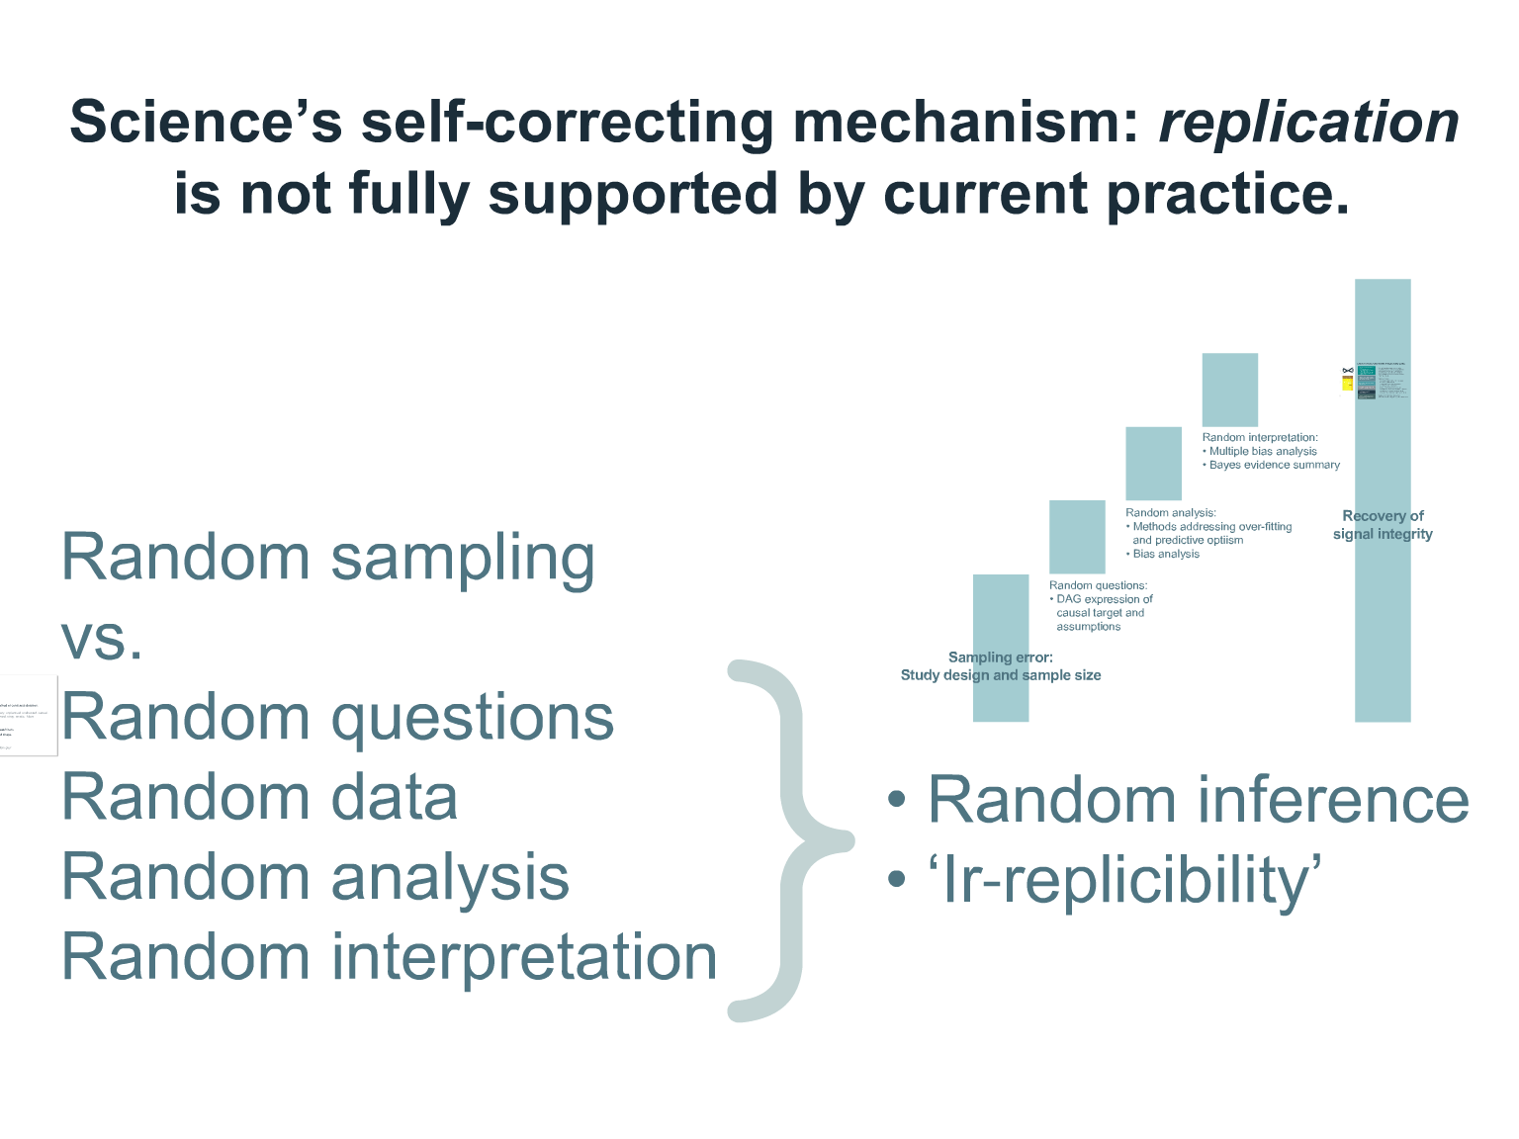
Notes:
It is not just sampling error that creates the “noise” and uncertainty in the system.
In a communication channel, signal redundancy is critical for uncertainty reduction and enhancing message integrity. “Replication” is the way science effects signal redundancy.
But effective replication is problematic. Compounding sampling error are randomness in the specific scientific questions posed (the specific propositions evaluated), inconsistency in the data analyzed in different studies, inconsistency in the quality of the analyses, and human factors affecting interpretation and judgement.
Nevertheless, there are things we can do in ODA to enhance the integrity of the signals that nature sends us.

Slide 19
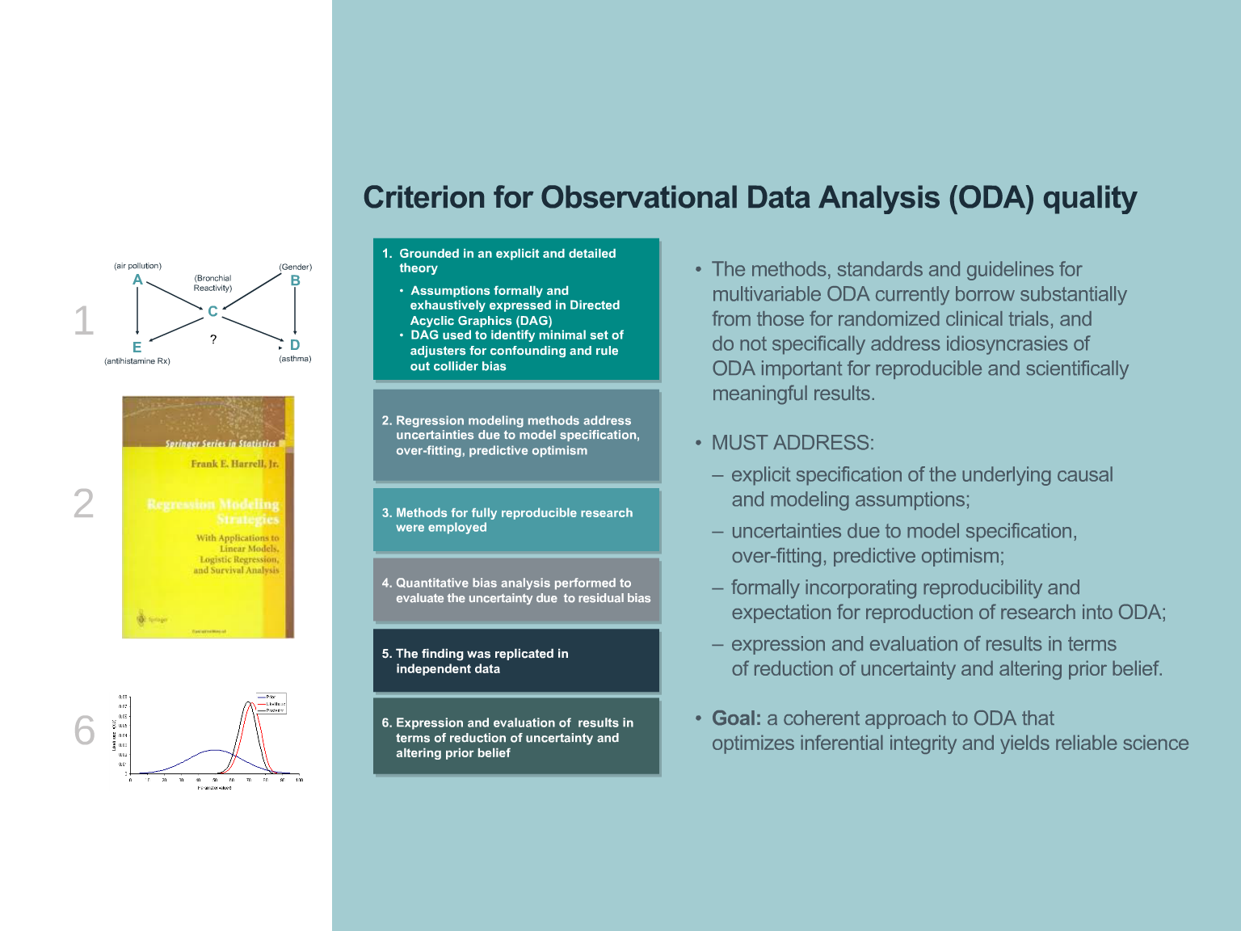
Notes:
Things we can do in ODA to enhance the integrity of the signals that nature sends us.
Proposed not as a set of “rules” that determine study qualification, but as a set of values that should influence it.

Slide 20
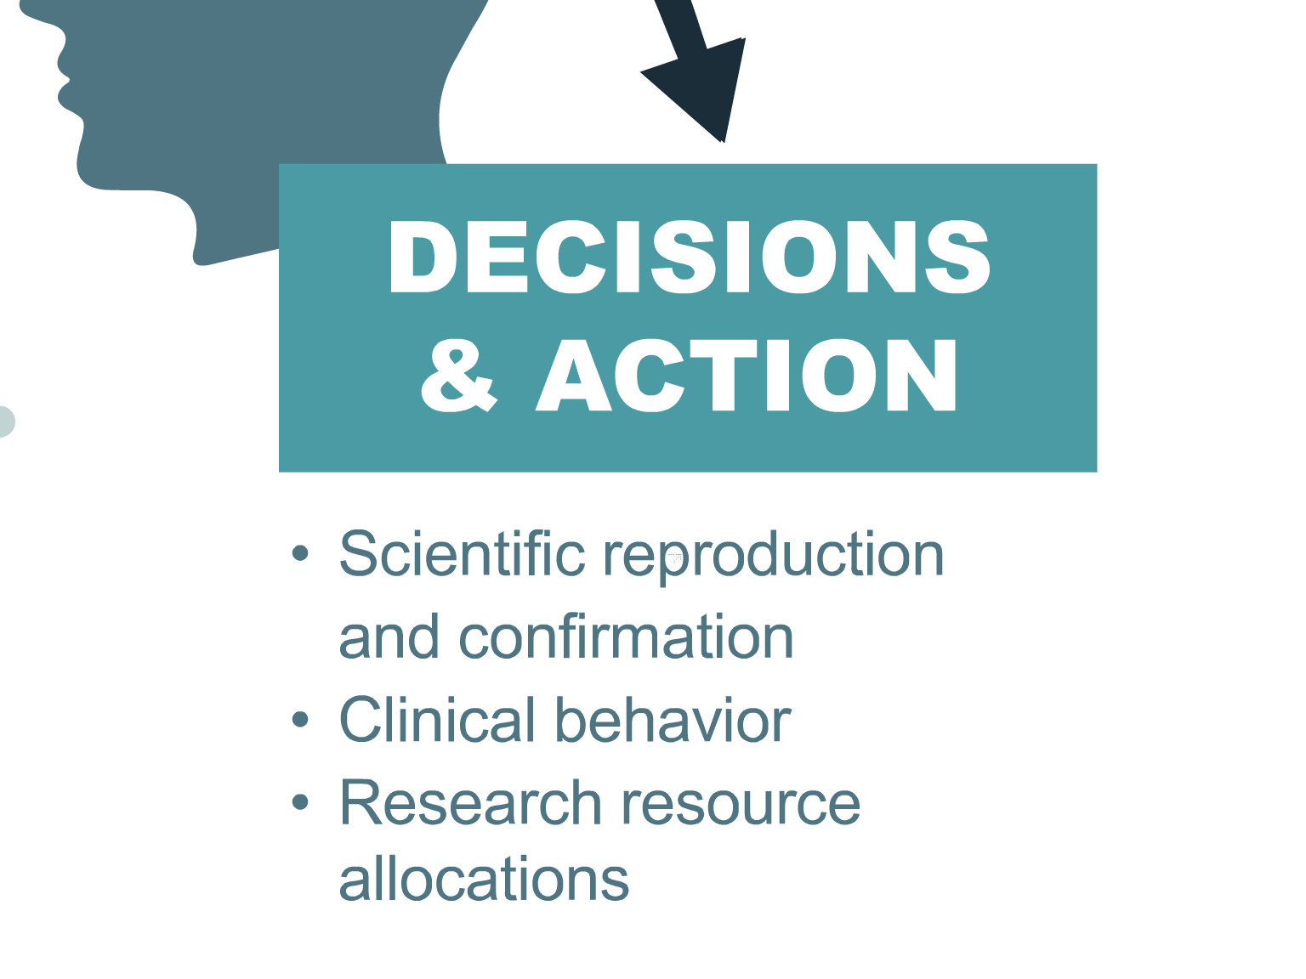
Notes:
*Also the decision of whether to publish or not (related to publication bias).
These are the penultimate conduits of the scientific process informing the clinical knowledge base through which the “message” is conveyed.
Distinguishing between judgements about evidence vs. clinical decision making is critical.
We ought to bear in mind that clinical decision making (decisions about actions) should be distinct and separate from analysis, inference and knowledge accrual (judgements about evidence). These are different processes with separate objectives. Probability (e.g., a p-value) itself is not a decision. Clinical decision making does take evidence into account, but must also take into account the individual prognosis, utilities, and interests of the individual patient.

Slide 21
The communication channel through which the “message” is conveyed informing the clinical knowledge base
Cumulative, compounding noise degrading signal fidelity: entropy in information
Methods and guidelines for enhancing integrity of ODA proposed
How might we decide what kind of evidence to use for personalized health care decision making? ODA/”RWE” vs. RCT?
How might we understand and evaluate evidence quality (Value of Information)?
Notes:
We have surveyed the scientific process informing the clinical knowledge base through which the “message” is conveyed.
Cumulative, compounding noise degrading signal fidelity: entropy in information
Methods and guidelines for enhancing integrity of ODA/”RWE” proposed
How might we decide what kind of evidence to use for personalized health care decision making? ODA/”RWE” vs. RCT?
How might we understand and evaluate evidence quality (Value of Information)?

Slide 22
Notes:
ODA/”RWE” vs. RCT?
We make trade-offs: bias, clinical relevance, precision, timeliness, cost to acquire information.
What is the relative “value of Information”?

Slide 23
Evidence Quality for Personalized Health Care Decision Making
Notes:
Exploring methods for evaluating the relative information yield and relative value of evidence.

Slide 30
Notes:
This has been our journey though various issues in evidence quality and personalized health care decision making: through managing uncertainty in scientific process informing the clinical knowledge base

Slide 31
‘If a Man will begin with certainties, he will end in doubts; but if he will be content to begin with doubts he will end in certainties.’
Francis Bacon

Slide 33
Change in belief

Slide 34
Change in uncertainty

Slide 35
Managing uncertainty
Uncertainty dynamics: understand the sources of uncertainty and represent them
Information theory: think of evidence generation as a communication channel; capacity, noise, error, efficiency
Learning: construct models updated with new information: evidence = material change in uncertainty & totality of information
Behavioral economics: of judgement and decision-making
Decision oriented: start with the ultimate decision (e.g. personalized health care choices).

Slide 36
Details available at:
Github: https://github.com/drewglevy/QSU081718
Website set up for today: https://netlify …..TBA
Frank Harrell, Regression Modeling Strategies: http://biostat.mc.vanderbilt.edu/wiki/Main/RmS
Journal of Precision Medicine article: “Precision Medicine is a Value-of-Information Proposition---and Vice Versa”, 2015.

Slide 37


Slide 38


